Slide 1
Pneumonia Detection

Slide 2
Classifying Chest X rays as Pneumonia or Normal
Dealing with Image data sets.
Performing Data Processing and Augmentation as and when required.
Creating and training a Convolutional Neural Network using Tensorflow 2.0

Slide 3
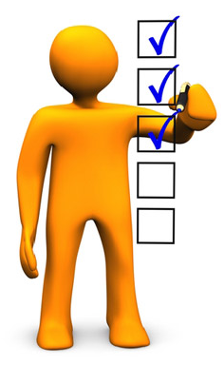
Pre-requisites
Good Knowledge of Python programming language.
In depth knowledge over Linear and Logistic regression
Understanding of Basic Image processing.
Basic Understanding on Artificial neural networks and Convolutional neural networks Working and Implementation.

Slide 4
Pneumonia

Slide 5
What Is Pneumonia?
Pneumonia is an infection that inflames air sacs in one or both lungs infection can be life-threatening to anyone.
The germs that cause pneumonia are contagious.
Both viral and bacterial pneumonia can spread to others through:
Inhalation of airborne droplets from a sneeze or cough.
By coming into contact with surfaces or objects that are contaminated with pneumonia-causing bacteria or viruses.

Slide 6
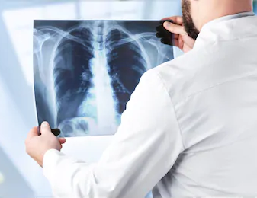
Symptoms
Coughing that may produce mucus.
Sweating or chills.
Shortness of breath.
Breathe or cough.
Feelings of tiredness or fatigue.
Loss of appetite.
Nausea or vomiting.
Headaches.

Slide 7
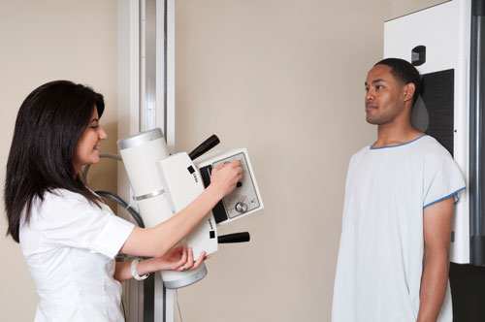
Physical Check-Ups
‌Chest X-ray.
‌Blood Culture.
‌Sputum Culture.
‌Pulse Oximetry.
‌CT scan.
‌Fluid sample.
‌Bronchoscopy.

Slide 8
Chest X-Rays related to Pneumonia disease
An X-ray exam will allow a doctor to see lungs, heart and blood vessels etc to determine the presence of pneumonia.
Infiltrates that identify an infection.
Low contrast, overlapping organs and blurred boundary.
Medical value and application significance to construct a stable and accurate automatic detection model of pneumonia.

Slide 9
Environment Setup

Slide 10
Setup
To run on a normal CPU, having a ‘CUDA’ enabled GPU helps models get trained quicker.
‘Google’s Colaboratory’ is the developer's best friend when it comes to deep learning.
Colaboratory is a Google research project created to help machine learning education and research.
Hosted on Google Cloud instances which we can use for free.

Slide 11
Tensorflow Dataset API

Slide 12
Tensorflow Dataset API
The tensorflow dataset API helps us in writing custom and efficient input pipelines.
Dataset API is used for:
Creating a Stacked object for Input data and labels.
Applying transformations to the data.
Iterating over the object to fetch the data.

Slide 13
ResNets

Slide 14
ResNets
It was the time when ‘AlexNet’ was released and people were just trying to build bigger and bigger networks.
Bigger networks were actually getting better accuracies but there was a limit and after that the errors went higher i.e. no improvement in performance.

Slide 15
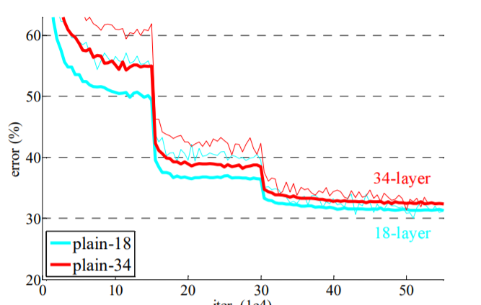
Issues using Plain Convolutional Networks
Validation errors for two plain convolutional networks
18 layers.
34 layers.
The error for a 34 layers network is higher compared to 18 layers.

Slide 16
Issues using Plain Convolutional Networks
Adding more layers can lead to more complex learning functions which might lead to an overfitting situation.
Deeper networks might face an issue backpropagating the gradients, this issue is most commonly called the ‘Vanishing Gradients’ problem.

Slide 17
Solution
Overfitting can be handled by using regularization and dropout where we deactivate few random neurons to help other neurons learn.
‘Vanishing Gradients’ problem can be handled using ‘ReLu’ activation which maximizes the gradient flow, we can use ‘Batch Normalization’ to address this issue as well.

Slide 18
ResNet Background
“A deep network should perform at least equal to its shallow counterparts.
Consider a Network where Initial layers are the shallow network and remaining layers are Identity functions.”

Slide 19
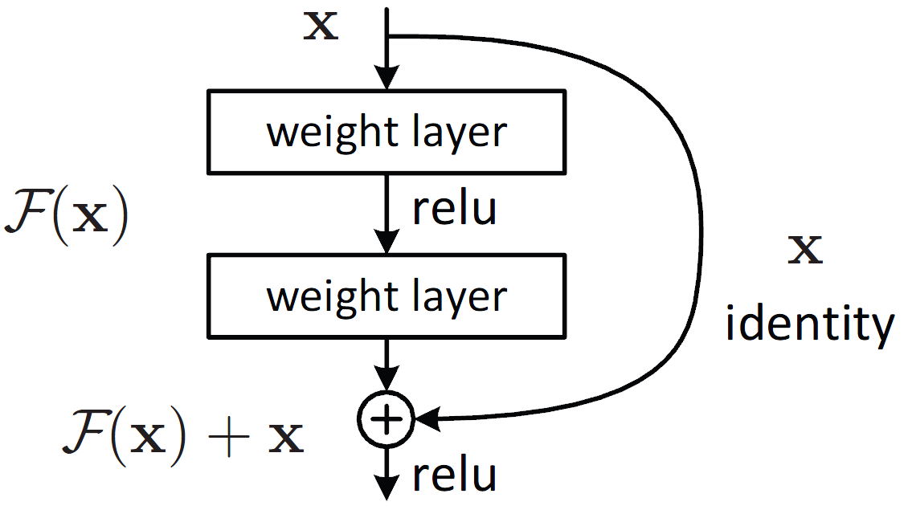
Residual Block
A residual block takes in the output of a layer and forwards the output to further layers.
It also remembers the past information which is nothing but the identity function.
This type of connection is also called “Skip connection”.

Slide 20
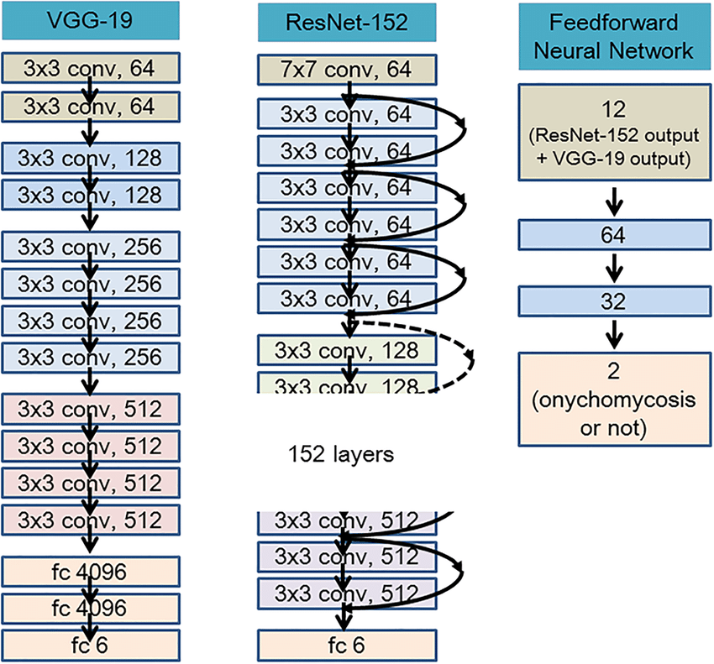
Deeper ResNet
They are very similar to each other except for the skip connections part.

Slide 21
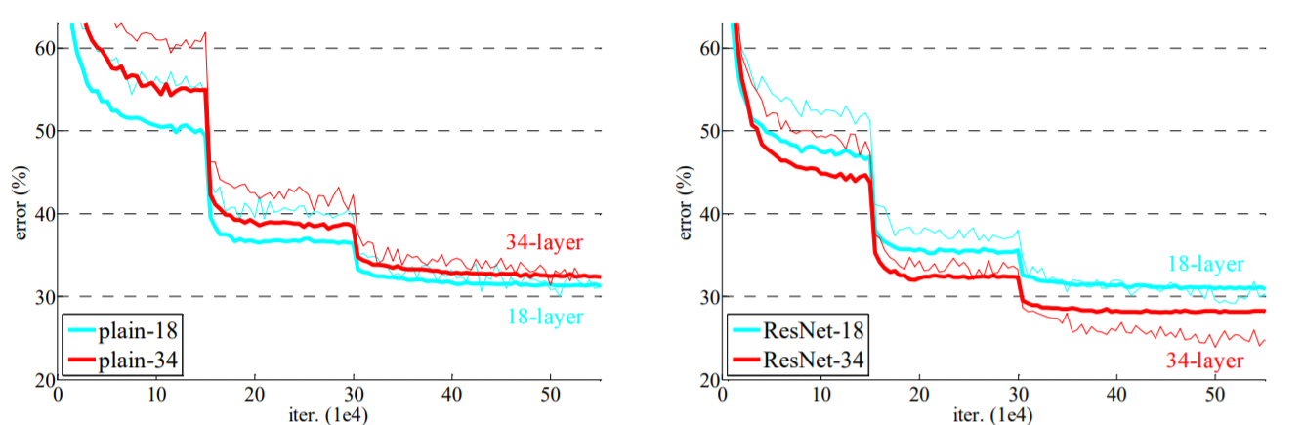
Plain Networks vs ResNets
There is not much difference in validation errors of plain 18 layers and resnet 18.

Slide 22
Plain Networks vs ResNets
Difference starts showing up when we use deeper models like resnet 34 and resnet 50.

Slide 23
Plain Networks vs ResNets
Validation error for 34 layer resnet is significantly lower compared to its plain counterpart.
Difference will keep increasing with increase in the number of layers.

Slide 24
Model Checkpoints

Slide 25

Tensorflow Callback Object
A Tensorflow callback object is used to perform an action in various stages of training process.
It could be at Start or End of an Epoch or Step.

Slide 26
Key Takeaways

Slide 27
Key Takeaways
We need to apply some Resampling Techniques to make it balanced.
We need to apply some Data Transformation techniques.
We Must Perform Univariate and Bivariate Analysis to understand the Better.
Finally, Try more and more Predictive Models, Compare them using various Evaluations Metrics is a good way of finding the Best Model.

Slide 28
More Things
to Try

Slide 29
More Things to Try
Medical problem statements are complex and there's a high chance to miss some important point before solving the issue.
X-ray scanners made by different companies do post processing in different ways.
Changes are huge in pixel level.
To improve the existing dataset by collecting X rays from multiple hospitals and different machines.

Slide 30
More Things to Try
Augmentation
Augmentation is the tricky part in medical imaging.
We cannot use most of the augmentations
It might change the image itself.
To use augmentations which do not affect pixel values like horizontal rotations , random image cropping.
We could also try out Blurring images in a minimal way.

Slide 31
More Things to Try
We have used only 2 callbacks.
Like “LRScheduler” or “Reduce on Plateau” or build one custom callback.
We have ‘Inception’ networks ‘EfficientNets’ , ‘NasNets’.
We need to try out different Models , compare the performance and then move forward with one of them.

Slide 32
Summary

Slide 33
Summary
Google Colab and GPUs.
Datasets consist of Images, Text, and Videos.
to Set up the environment for Solving Deep Learning Problems.
How to use Tensorflow to build Convolutional Neural Networks.
Identify and detect pneumonia from the Chest X Rays using the ResNet Architecture.
Real time Response using APIs.

Slide 34
Summary
Advanced Techniques to enhance the working of our Deep Learning Models.
Fruits Recognition:
Recognize different Types of Fruits.
It will give you a High Level Confidence for Performing Images Processing and Image Classification Tasks.

